Slide 1


Slide 2

Project Team
Name | Roll.No | Module Working on
Rahul C. D’costa | 1337 | Admin_UI
Siddhesh Naik | 1329 | Feedback
Shirish Parsekar | 1306 | Compare_bike
Sweta Nagvenkar | 1323 | Check_details
Prajakta Sail | 1325 | Check_details
Arpana Pandey | 1358 | Suggest_bike

Slide 3
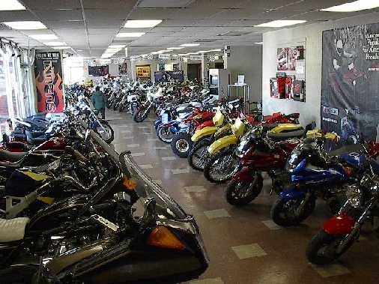
Problem Statement
Bike Showroom System
A vehicle showroom’s UI targeted towards the customer to access the bike’s that are available in that particular showroom.

Slide 4

The W’s and How
Who :- The Customers and Salesperson
What :- When a customer comes to a showroom he is attended by a salesperson , so the salesperson is not able to tell in details about each thing of the various different bikes in the showroom.
Why :-Customers cant choose the bikes by calculating all possible angles and increasing the sales of the bikes is slower.
Where :- Customers face problems as all details of the vehicle being purchased is not made available as the salesman cant tell you everything..
How :- By designing a Simple Interactive UI using TCL/TK

Slide 5

The Scope
PROJECT OBJECTIVE
Making a simple Interactive UI which will allow user/customer to do operations below once the desired vehicle is entered
DELIVERABLES
1)Suggesting a vehicle for the user
2)Giving full Specifications of a Vehicle
3)Comparing the vehicle with other vehicle
4)Calculating Cost/Tax/Insurance
5)Showing photos/videos of the vehicle
6)Giving user ability to write /read a review

Slide 6

MILESTONES
18th September :- Decide over a Topic for C Mini Project
27th September :-Get Problem statement Approved
28th September :-Assign the Different modules to Group members
29th September :-Start Working Individual wise on Modules
Before 7th October :-Get the Pseudo code Approved
7th October :-Discuss any problems faced in development & discuss
about the prototype Model
20th October :-Get working model
21st October Onwards :-Start debugging, error handling, also improving the Model
Before 27th October :-Date of Completion

Slide 7
Hierarchy Chart
Bike_Showroom_System
Admin_UI
Intro
Customer_UI
Admin_Intro
Authenticate
Perfrom_Task
Suggest_Bike
Search_Bike
Display_Data
Accept_survey_answers
Display_Bikes
Suggest_
Terminate
Admin_Terminate
Survey_Intro
Add
Update
Delete
View
Search_
Intro
Accept_Bike
Check_details
Compare_Bike
Feedback
Display_Details
Search_
Terminate

Slide 8
Check_details SubChart
Check_details
Bike_Specification
Bike_Expenses
Bike_Gallery
Display_Details
Details_Terminate
Photos
Videos

Slide 9
Bike_compare SubChart
Compare_Bikes
Compare_Intro
Accept_details
Compare
Display_comparison
Comp_terminate
No_of_Bikes_To_Compare
Select_Bike

Slide 10
Feedback SubChart
Feedback
Feed_intro
Accept_option
Perform_Write_review
Display_feedback
Terminate_feed
Write_a_review
Read_a_review

Slide 11
Pseudocode
Main Module
1.Start
2.Call Intro Module
3.Call Customer_UI
4.Call Admin_UI
5.Call Terminate
6.Stop

Slide 12
//Customer_UI Module
3.1 Start
3.2 ACCEPT Choice 3.3 IF Choice = Suggestabike
3.4 Call Suggest_bike Module
//Suggest_bike Module
3.4.1 Start
3.4.2 DISPLAY Intro Message
3.4.3 ACCEPT Survey answers
3.4.4 DISPLAY bikes based on survey results
3.4.5 Call Suggest_Terminate Module
3.4.6 Stop
//End Suggest_bike Module

Slide 13
3.5 IF Choice = Searchabike
3.6 Call Search_bike Module
//Search_bike Module
3.6.1 Start
3.6.2 Call Search_Intro 3.6.3 Call Accept_bike 3.6.4 Read bike
3.6.5 Choose From a List
3.6.5.1 Call Check_details Module
3.6.5.2 Call Compare_bike Module
3.6.5.3 Call Feedback Module
3.6.6 Display Details
3.6.7 Call Search_Terminate
3.6.8 Stop
//End Search_bike Module
3.7 Stop
//End Customer_UI Module

Slide 14
//Check_details Module
3.6.5.1.1 Start
3.6.5.1.2 Call Specification Module
//Specification Module
3.6.5.1.2.1 Display Bike Specification
3.6.5.1.3 Call Expenses Module
// Expenses Module
3.6.5.1.3.1 Display Cost,Tax,Insurance,Service
3.6.5.1.3 Call Bike_Gallery Module
//Bike_Gallery Module
3.6.5.1.3.1. Display Bike Photos and Videos
3.6.5.1.4 Call Details_Terminate
3.6.5.1.5 Stop
//End Check_details Module

Slide 15
//Compare_bike Module
3.6.5.2.1 Start
3.6.5.2.2 Call Compare_Intro Module
3.6.5.2.3 READ No of Bikes and Bike names
3.6.5.2.4 Compare the bikes
3.6.5.2.5 Display Comparison
3.6.5.2.6 Call Comp_terminate Module
3.6.5.2.7 Stop

Slide 16
//Feedback Module
3.6.5.3.1 Start
3.6.5.3.2 Call Feed_Intro Module
3.6.5.3.3 Call Accept_option Module
//Accept_option Module
3.6.5.3.3.1 DISPLAY select a Option READ or WRITE
3.6.5.3.3.2 Read Option
3.6.5.3.4 Call Perform_Write_review
3.6.5.3.5 DISPLAY Feedback
3.6.5.3.6 Call Terminate_Feed Module
3.6.5.3.7 Stop

Slide 17
//Admin_UI Module
4.1 Start
4.2 Call Admin_Intro Module
4.3 Call Authenticate Module
// Authenticate Module
4.3.1 WRITE enter Valid userid and Password
4.3.2 Read Valid userid and Password
4.4 Call Perform_Task Module
//Perform_Task Module
4.4.1 READ Task

Slide 18
4.4.2 IF Task=View
4.4.2.1 Call Display_Data
4.4.3 IF Task=Add
4.4.3.1. Enter Specification,Expenses,Bike Gallery details
4.4.4 IF Task=Update
4.4.4.1. Enter Record to Update
4.4.4.2. Enter Specification,Expenses,Bike Gallery details
4.4.5 IF Task=Delete
4.4.5.1. Enter Record to Delete
4.5 Call Display_Data Module
4.6 Call Admin_Terminate Module
4.7 Stop
//End Admin_UI Module

Slide 19

Introduction to Tcl and Tk
The tool command language Tcl (pronounced tickle) is an interpreted, action-oriented, string-based, command language.
It was created by John Ousterhaut in the late 1980's along with the Tk graphical toolkit.
Tcl/Tk remains a handy tool for developers and administrators who want to rapidly build graphical frontends for command line utilities.

Slide 20
Basic Information
The TCL is a Scripting Tool so,save the files in .tcl extension. Eg: mycode.tcl
To Run a TCL Script make use of the command wish or tclsh The wish command will give a graphical Output,while the tclsh will give you a Commandline output. Eg: At command line type wish mycode.tcl
and using tclsh tclsh mycode.tcl

Slide 21
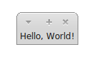
Runnig using wish command
Simple Hello World Script
label .hello –text “Hello World”
Pack .hello
Output

Slide 22
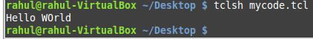
Running using tclsh command
Puts “Hello WOrld”
Output

Slide 23

Rough Look of The U.I.

Slide 24
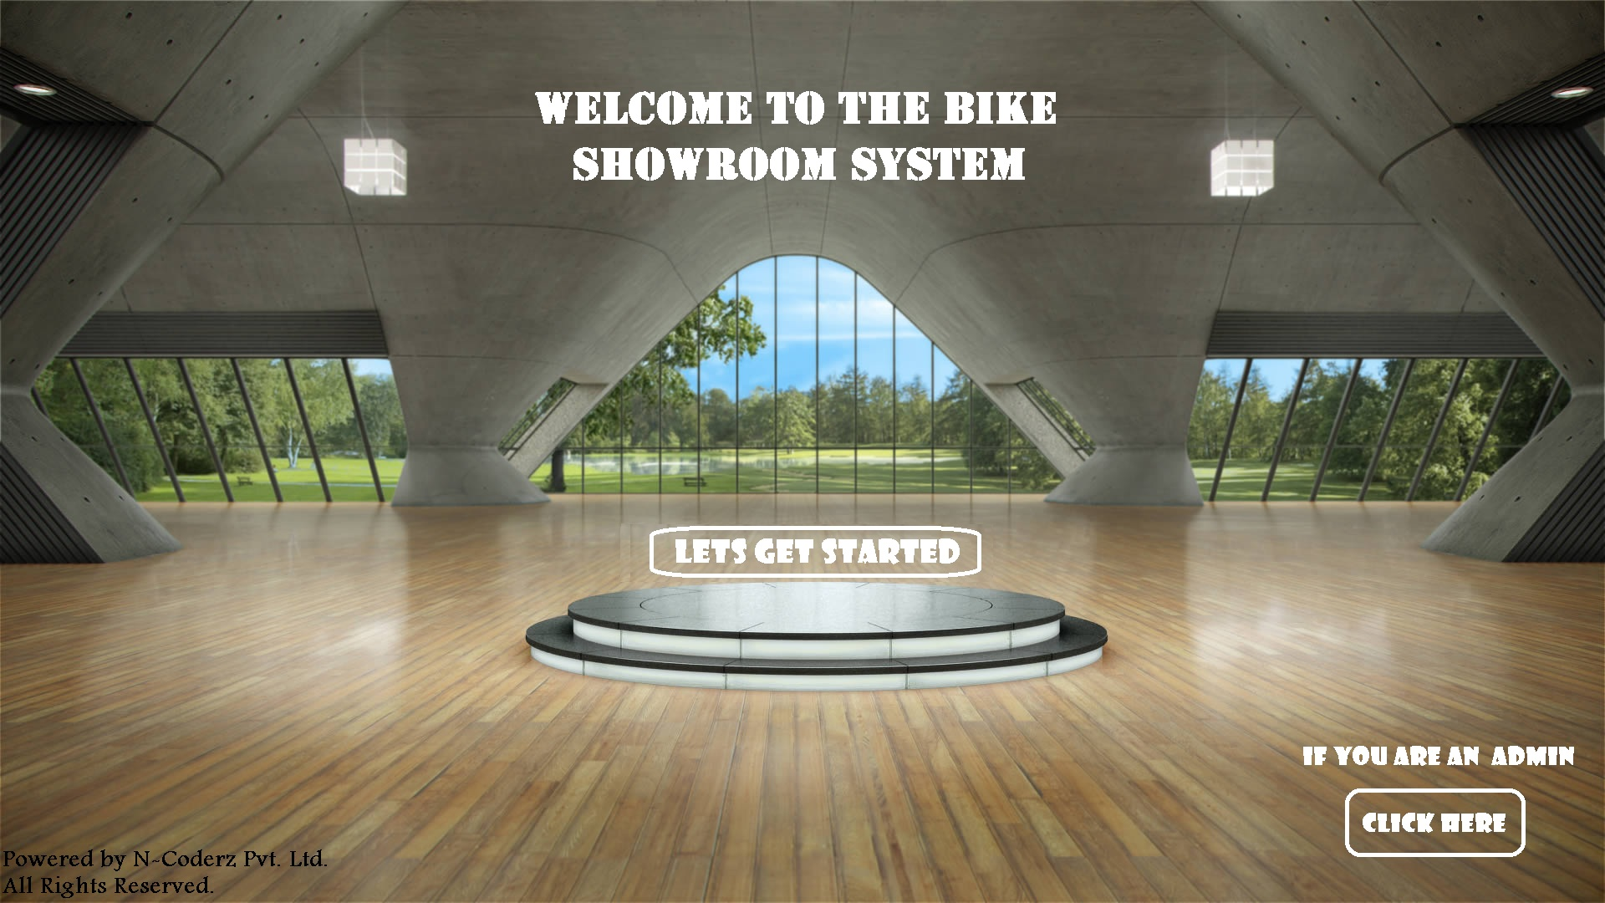

Slide 25
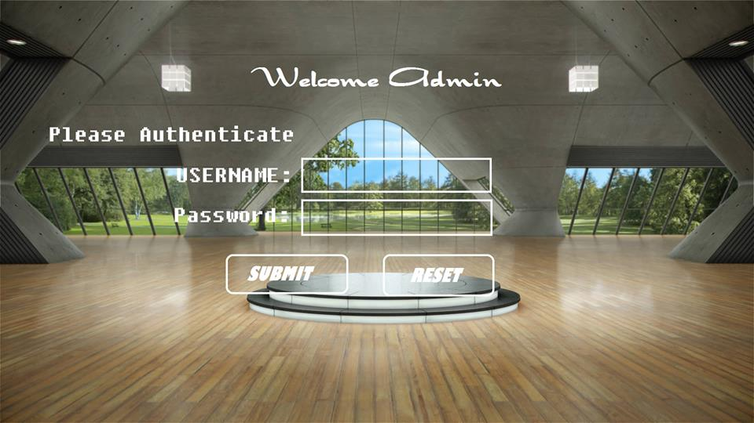
GO BACK

Slide 27
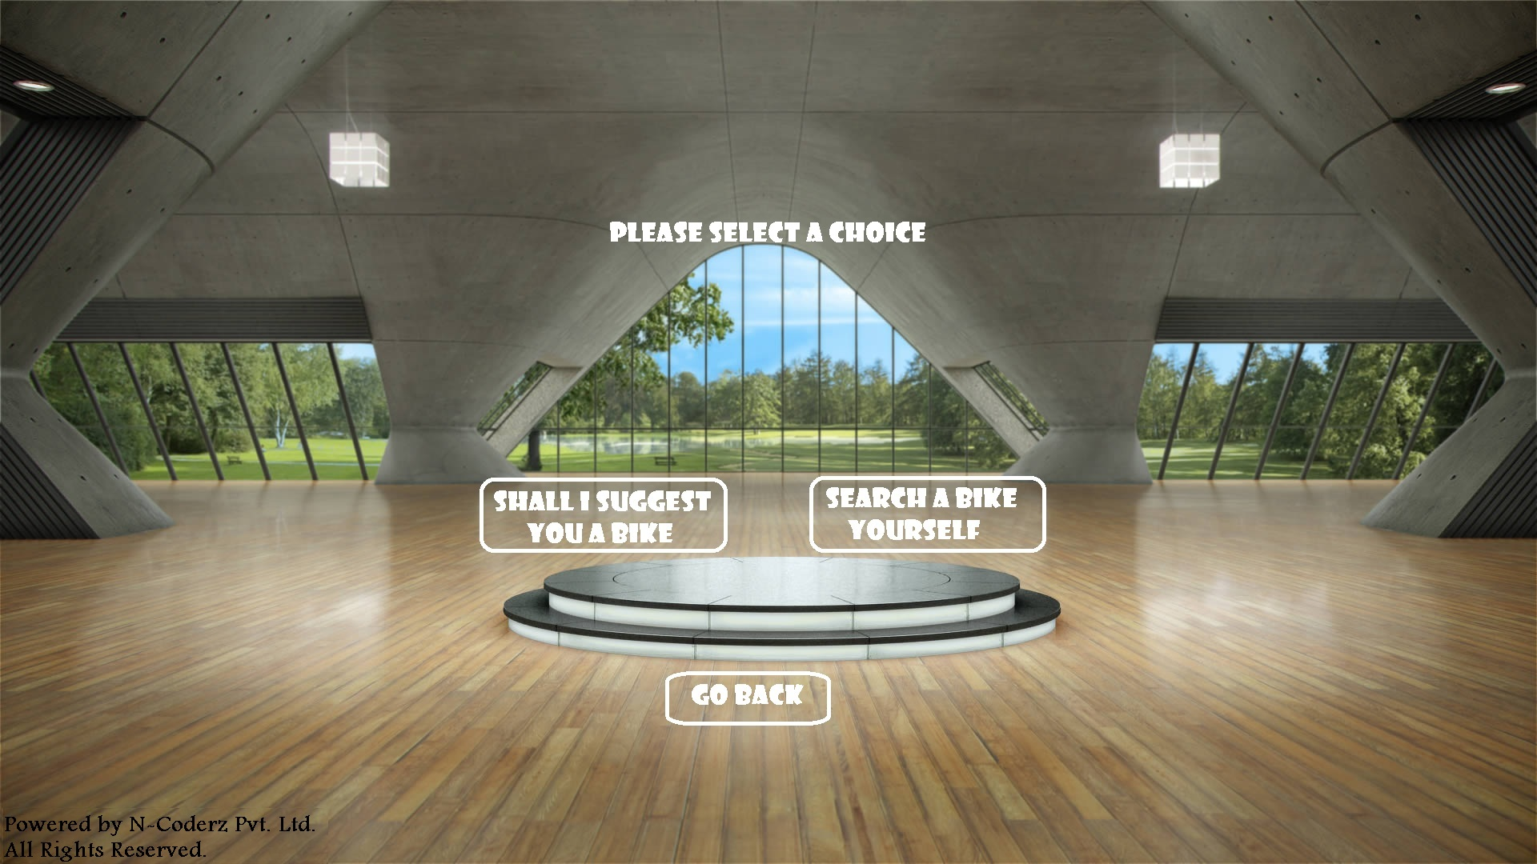

Slide 28
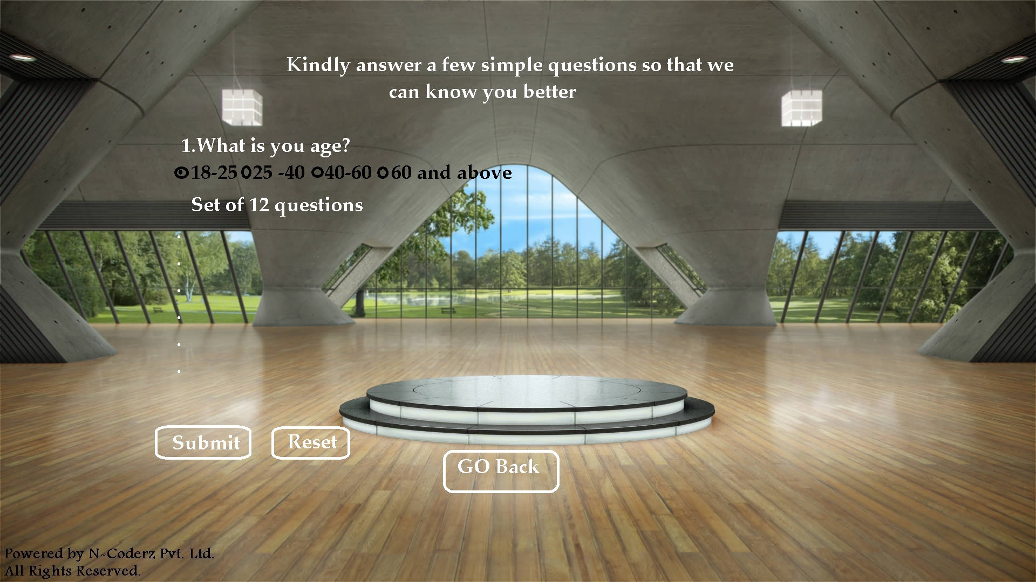

Slide 30
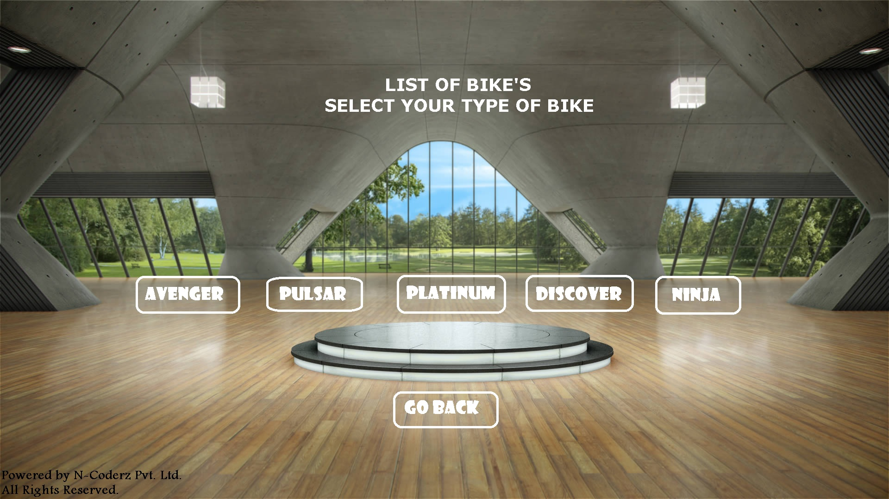

Slide 31
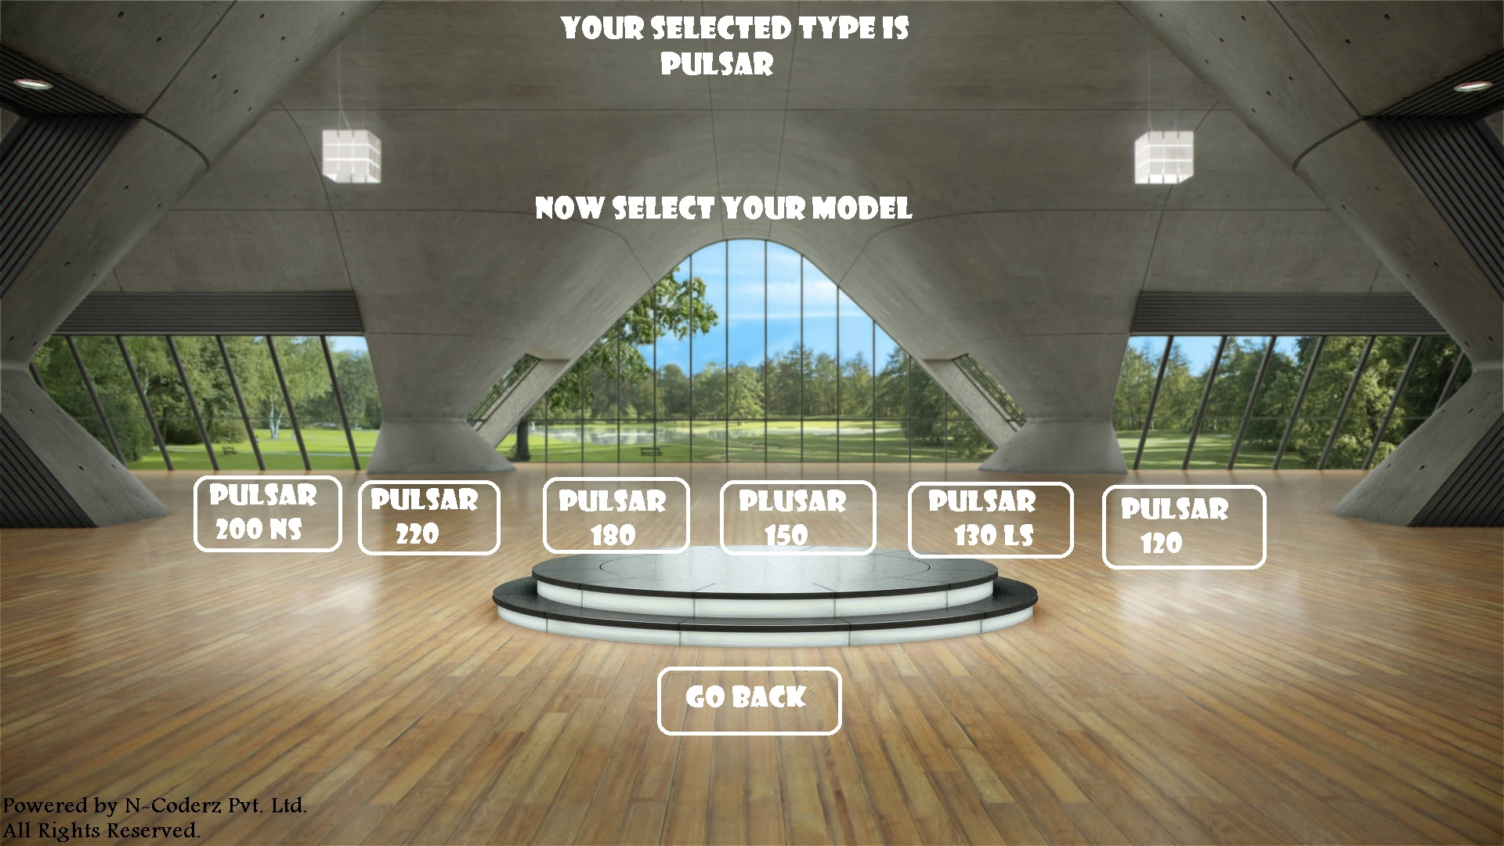

Slide 32
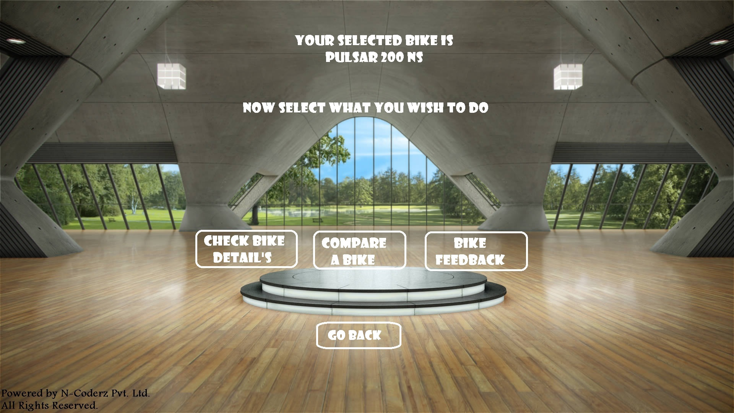

Slide 33
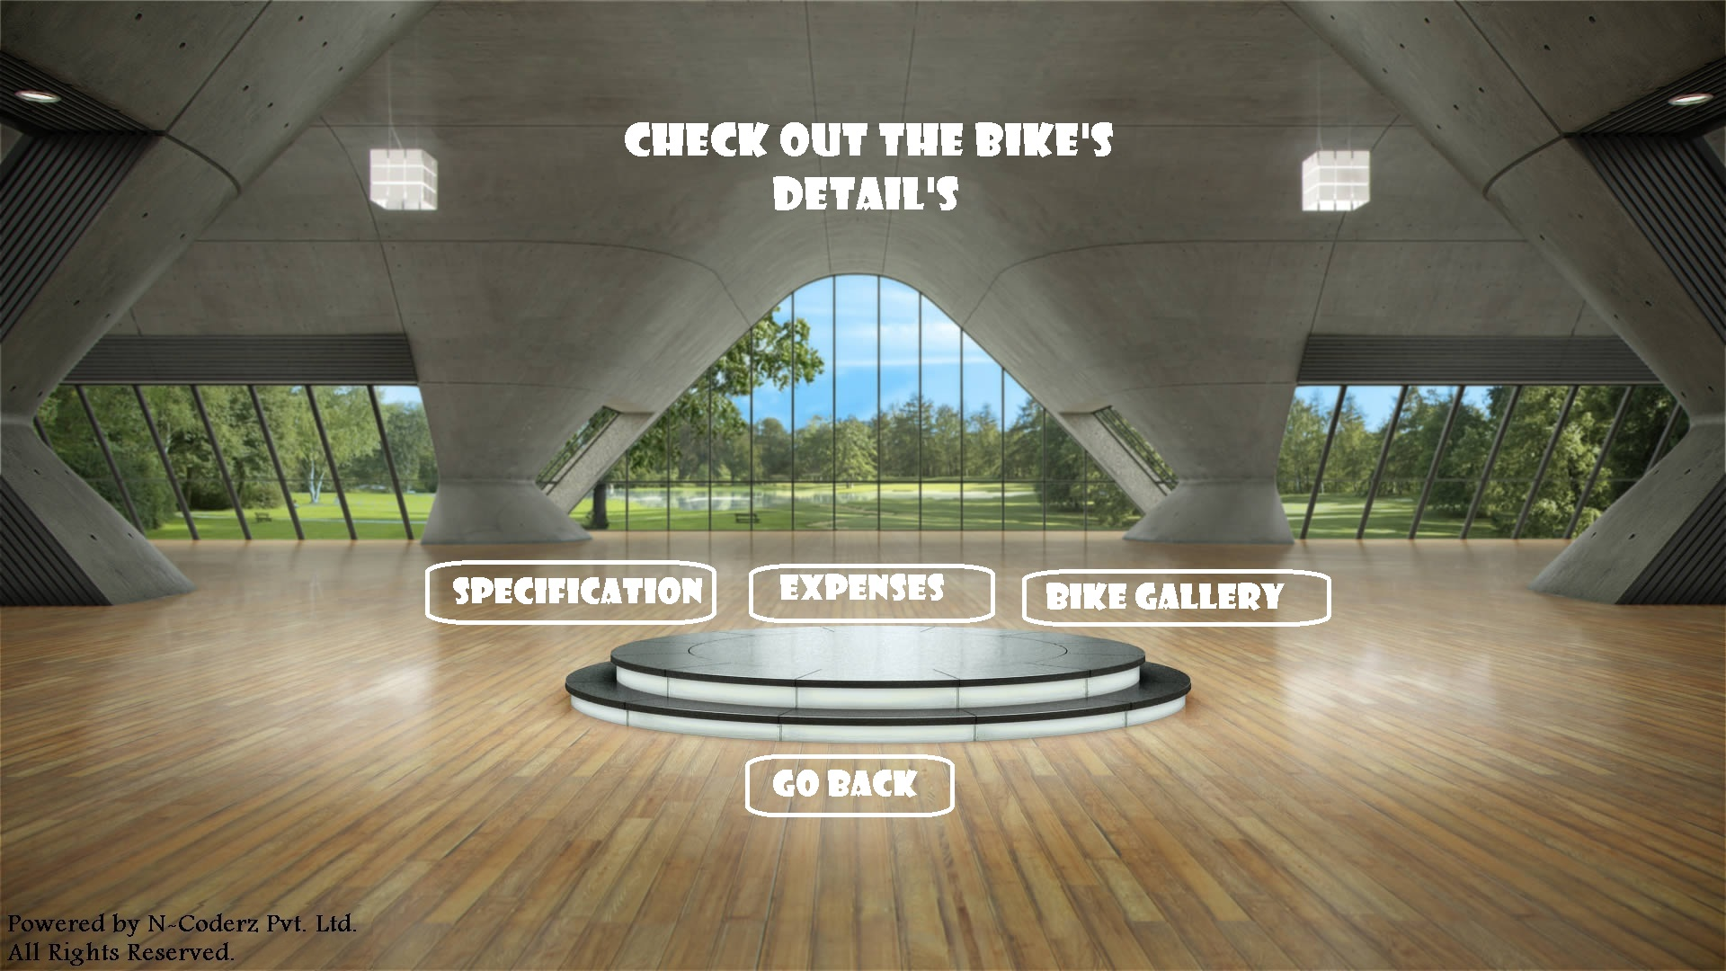

Slide 34
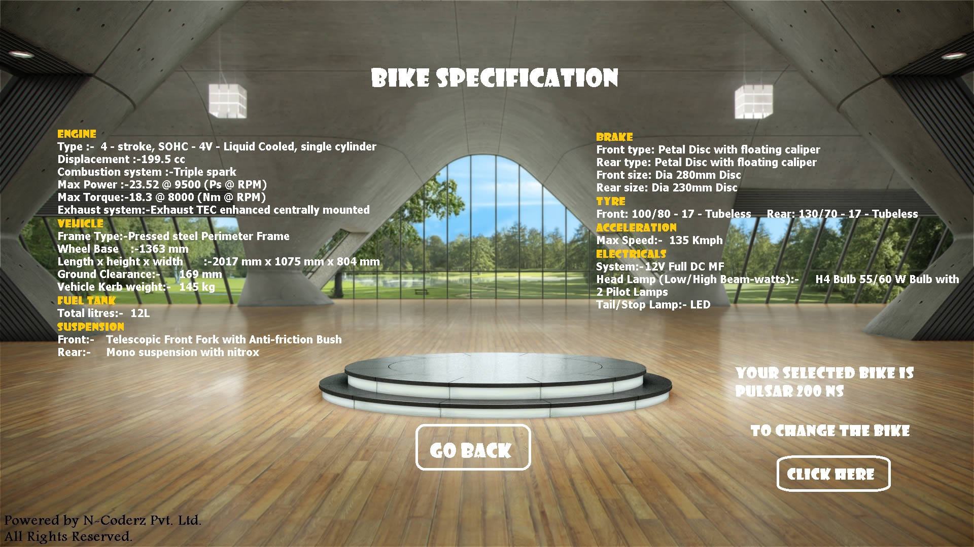

Slide 35
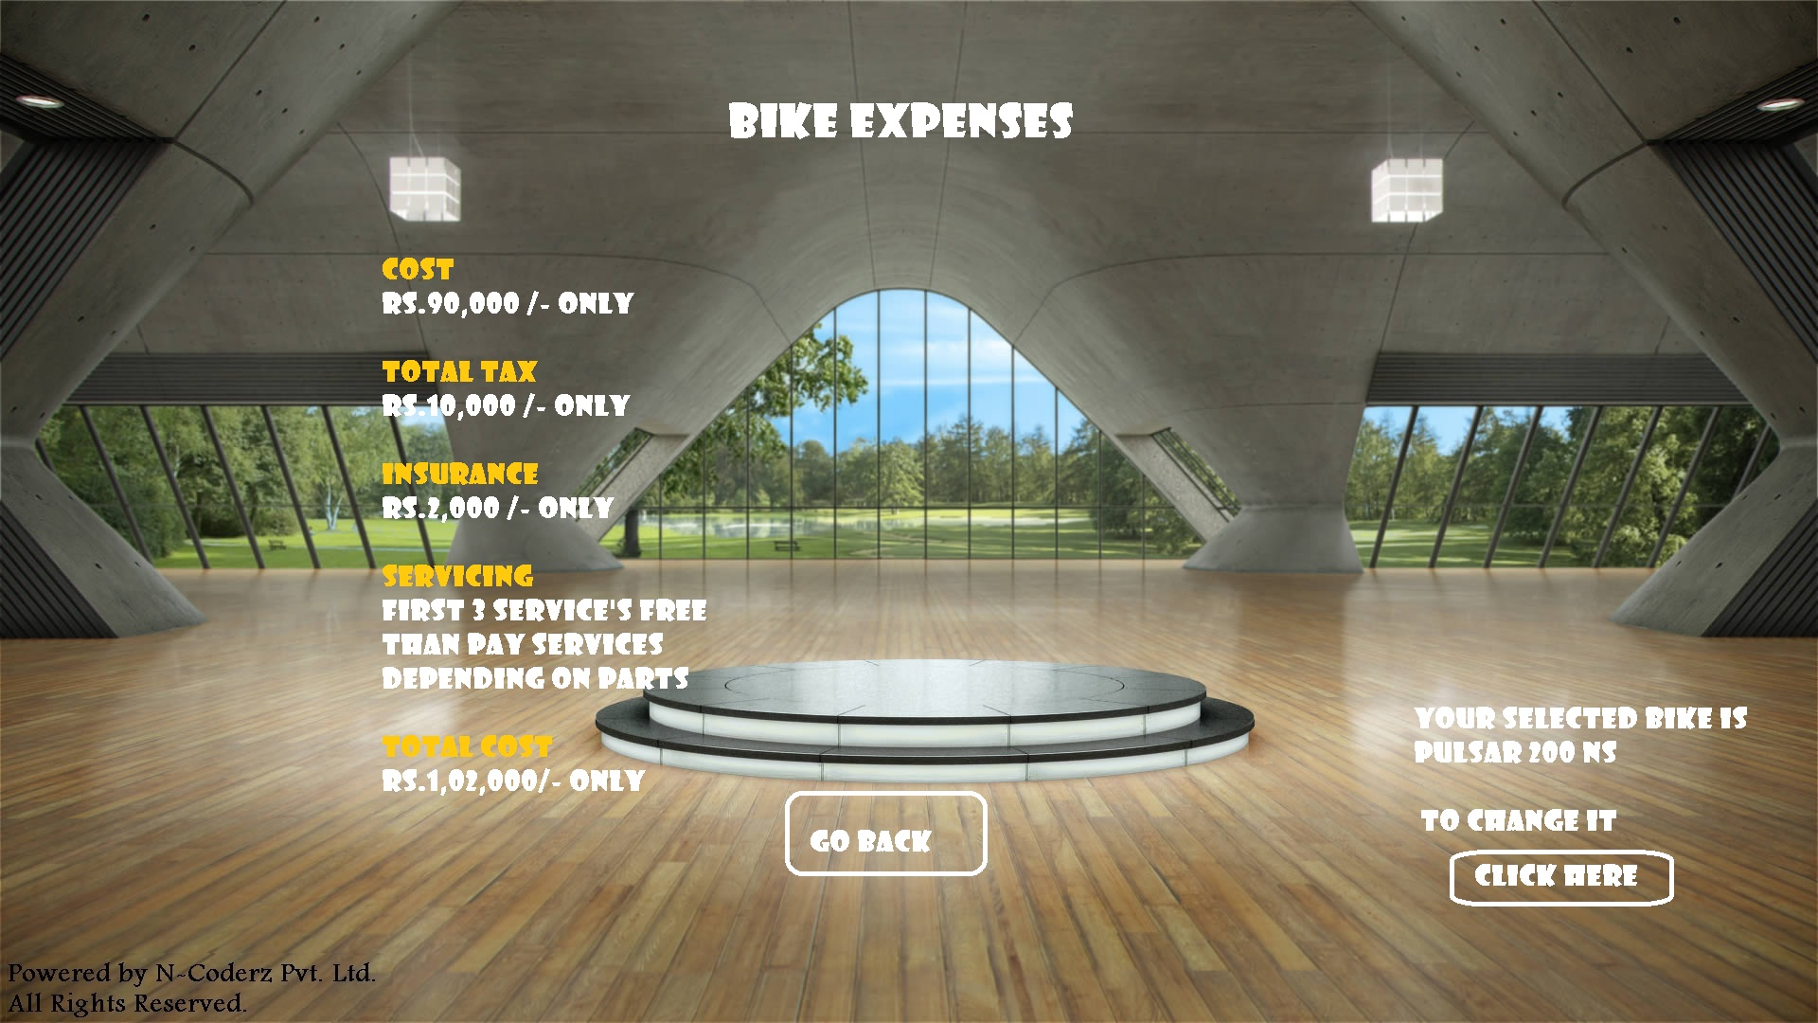

Slide 36
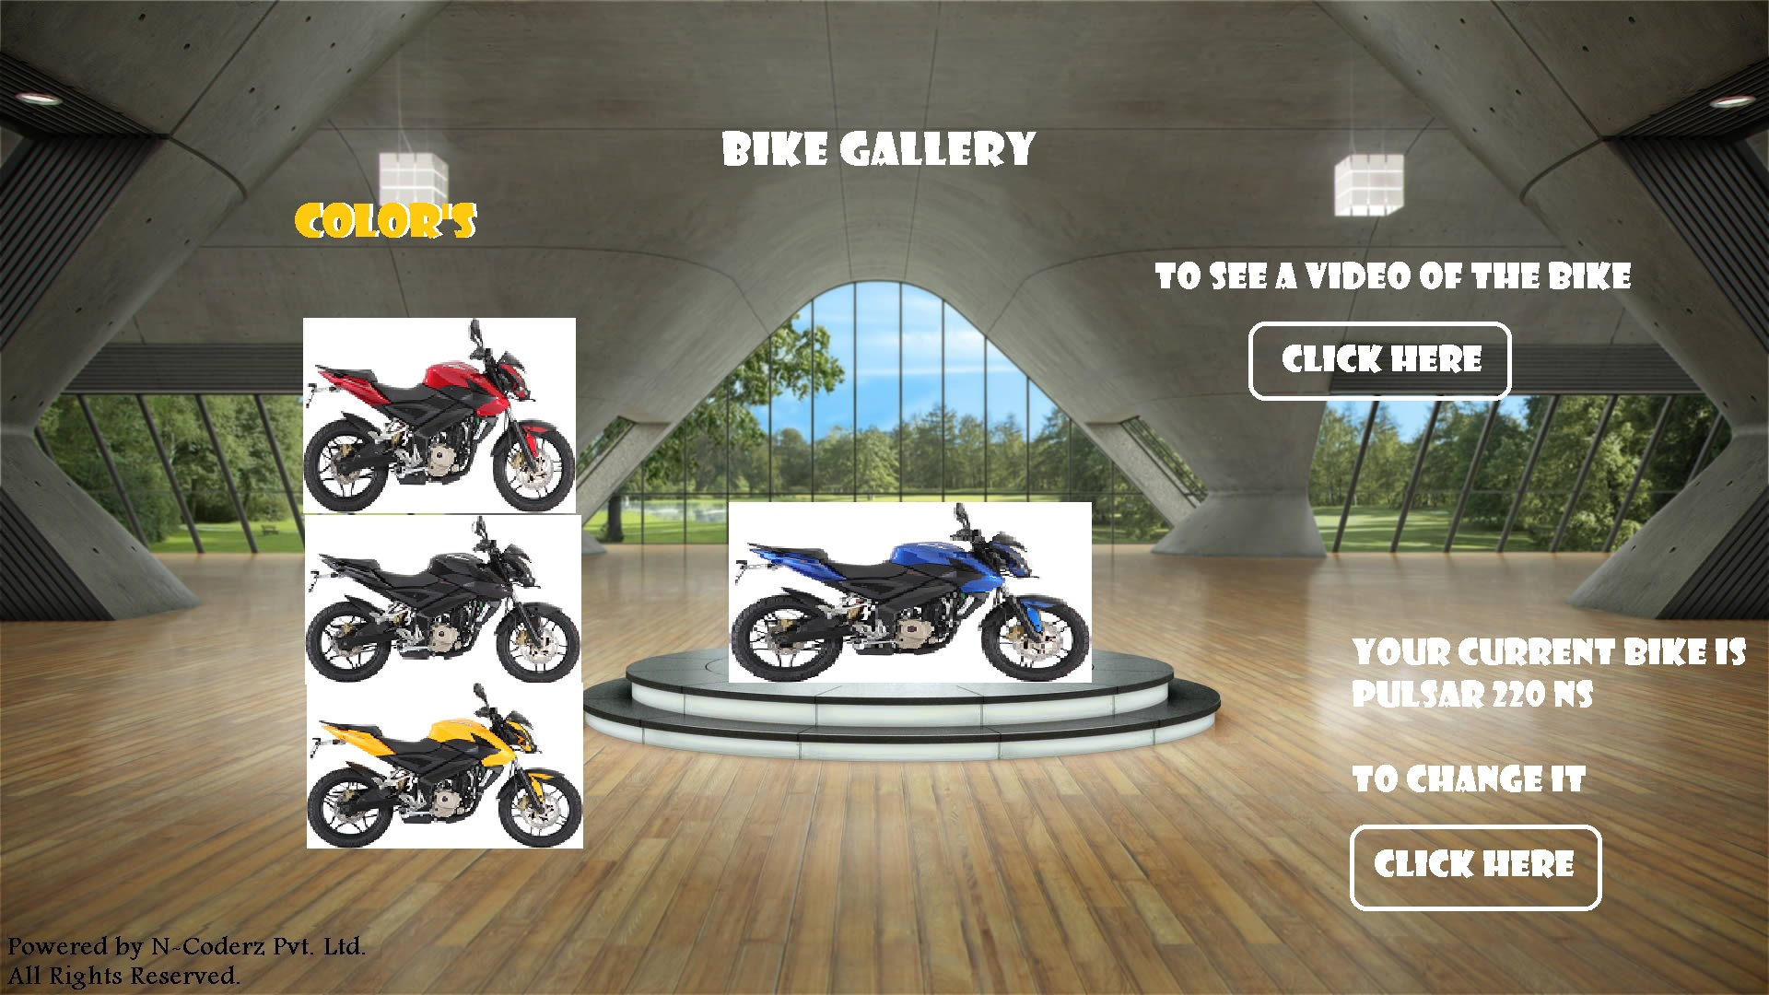


Slide 38
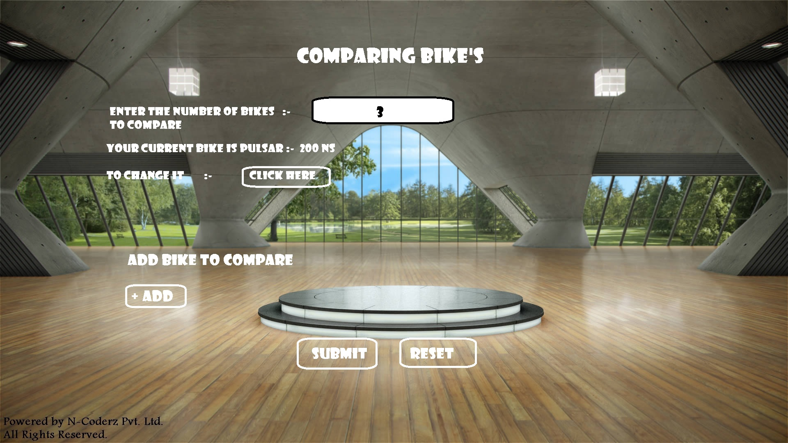
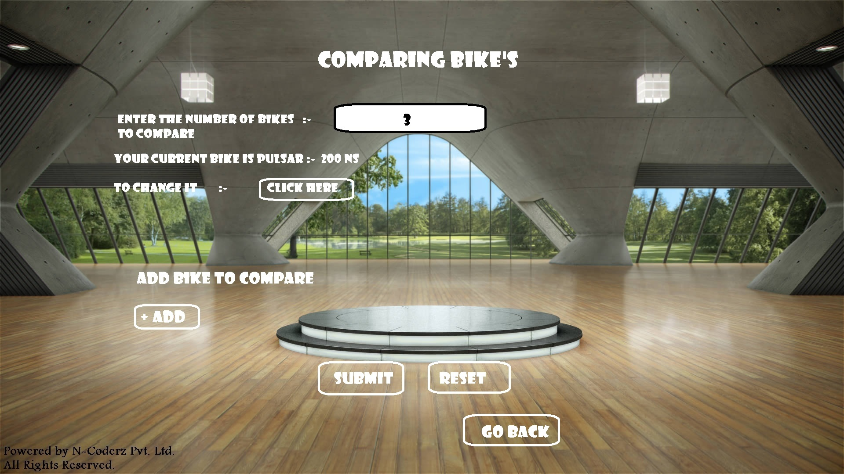

Slide 39
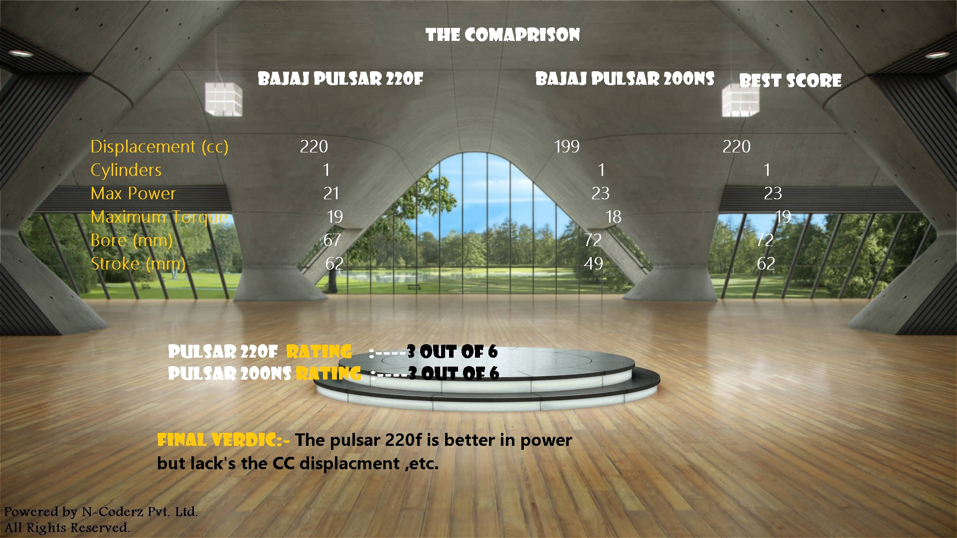
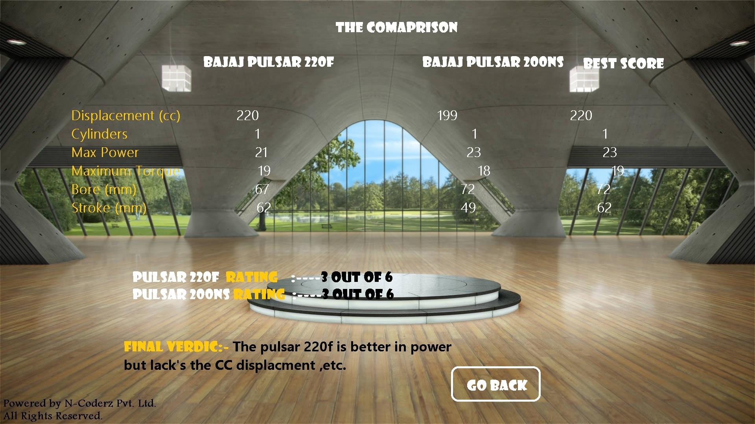

Slide 41
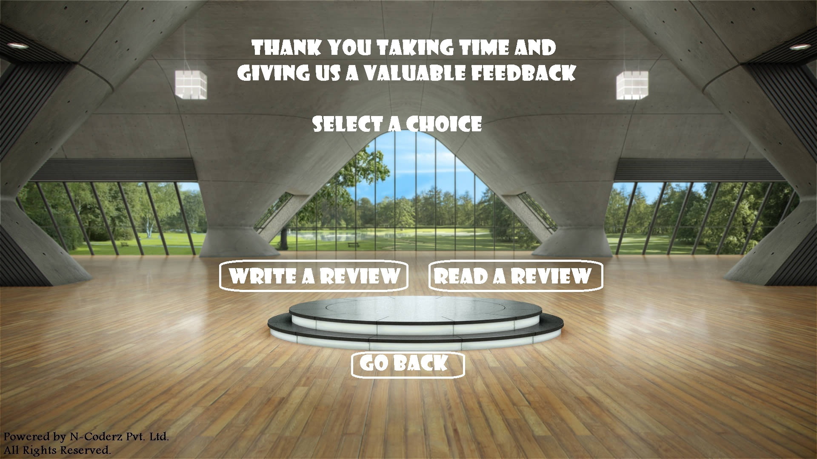

Slide 42
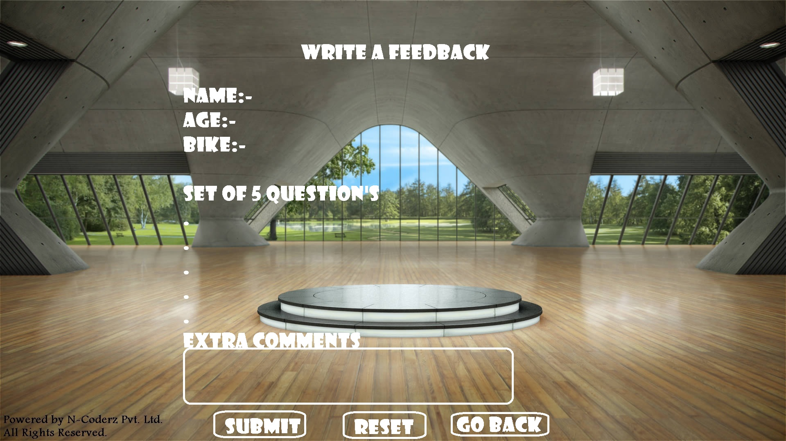

Slide 43
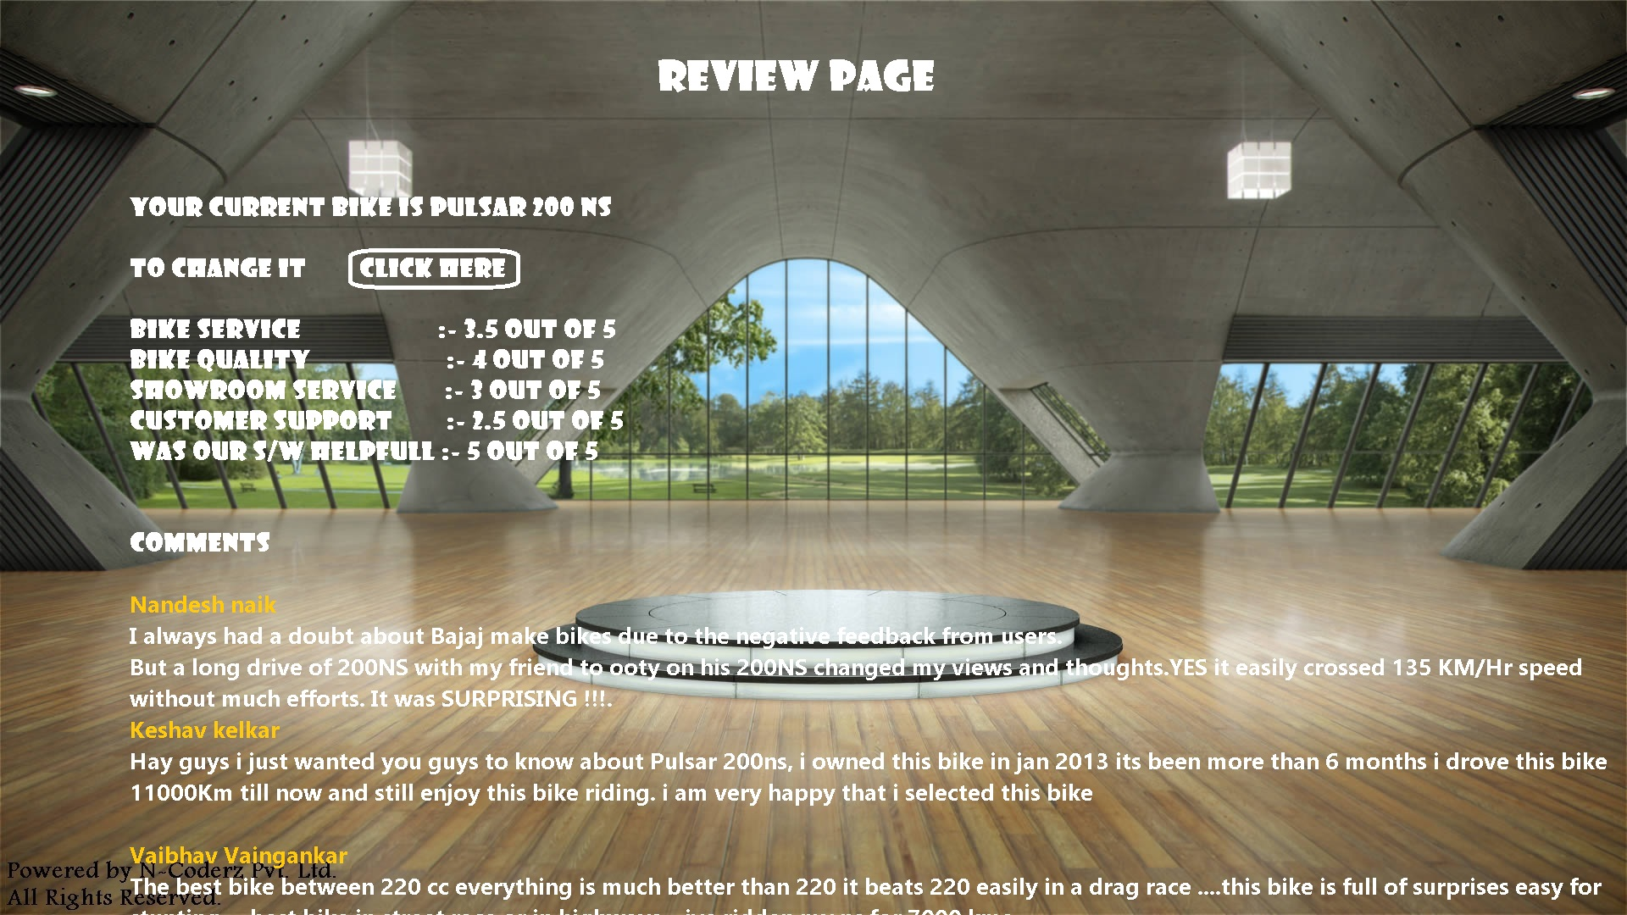
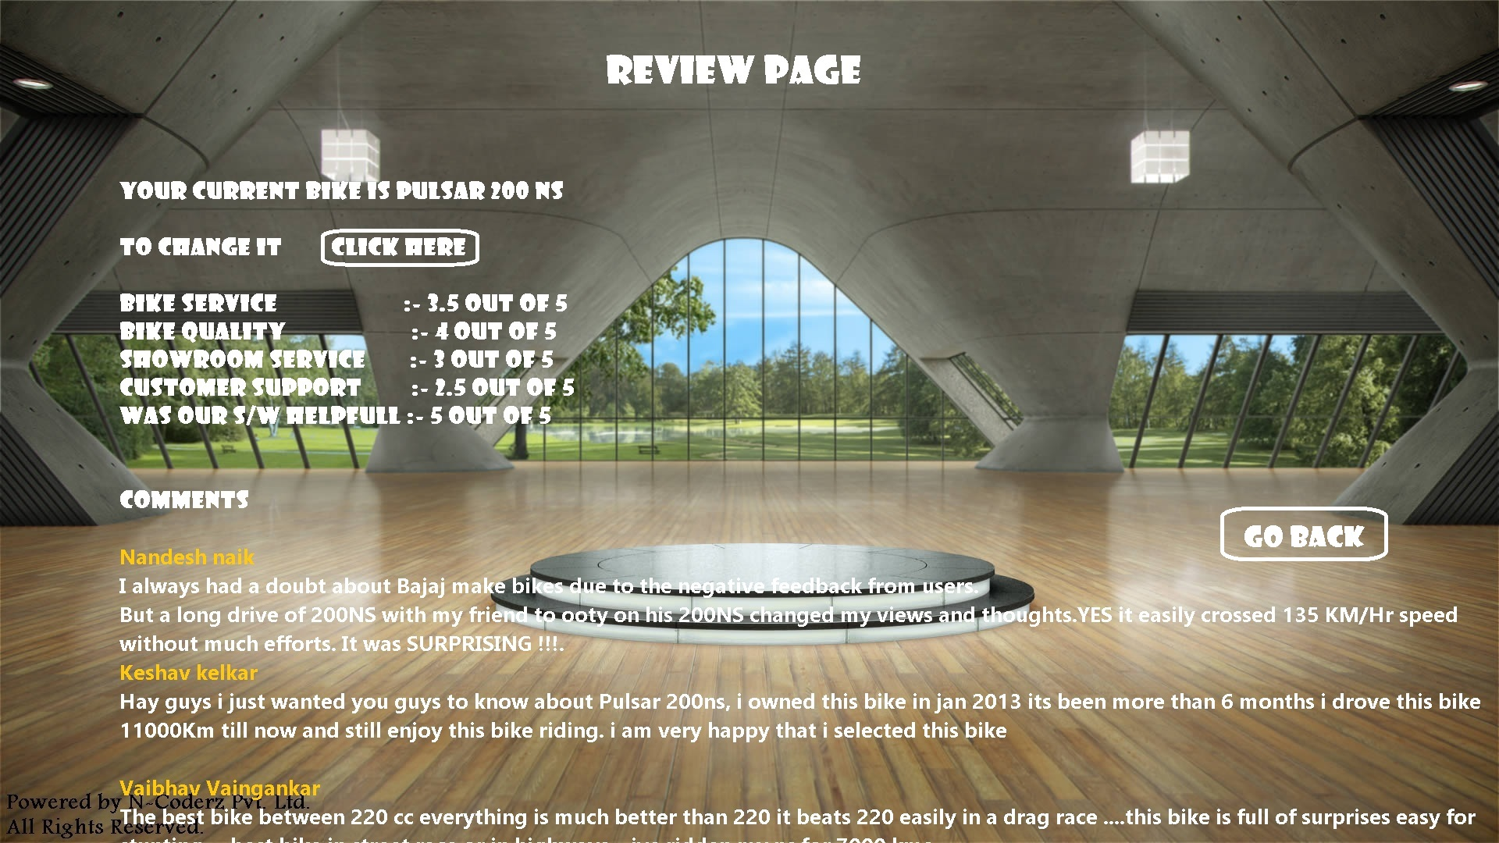

Slide 44

Motivation

Slide 45

Future Enhancement
Having Color selection for user of the UI,so that anyone can select desired color and use the UI
Inserting Videos of the Bike
Having Dynamic Feedback policy, so that feedback can be read on the Web
Ability for the user to change UI language like English,Hindi,Konkani

Slide 46

Acknowledgments
Sir Venkatesh P Prabhu for giving the idea for AI way of selecting bike which is our Suggest-bike module.

Slide 47
References
http://wiki.tcl.tk/488
http://wiki.tcl.tk/
http://www.bajajauto.com/
http://en.wikipedia.org/wiki/Tcl
http://www.google.com

Slide 48


